Slide 1
Sesi 1 - Jaringan Komputer Lanjut
Septian Cahyadi
Program Studi Teknologi Informasi Fakultas Informatika & Pariwisata
Institut Bisnis dan Informatika Kesatuan

Slide 2
Outline Materi
Sesi 1 - Jaringan Komputer saat ini
Sesi 2 - Pengalamatan Logik dalam Jaringan Komputer
Sesi 3 - Perangkat Jaringan
Sesi 4 - Alokasi IP Dinamis
Sesi 5 - Routing Statis
Sesi 6 - Routing Dinamis
Sesi 7 - BGP
Sesi 8 - UTS
Sesi 9 - DNS
Sesi 10 - Firewall
Sesi 11 - Gateway Server dan NAT
Sesi 12 - Proxy Server
Sesi 13 - QOS
Sesi 14 - Tunneling
Sesi 15 - Review/Quiz
Sesi 16 - UAS

Slide 3
Teknologi Jaringan Hari Ini

Slide 4
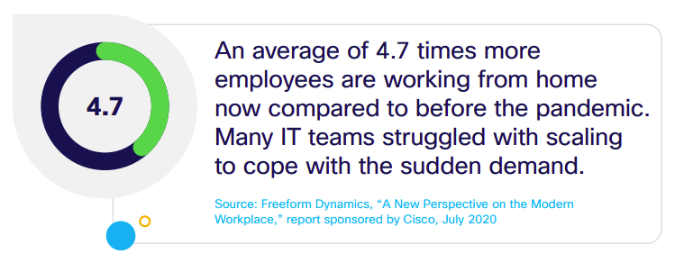
Trend #1: Workforce — Extending security to a remote workforce

Slide 5
IT new set of business requirements
Empowering workers to be productive and collaborative from anywhere
Optimizing IT performance, cost, and security for each worker
Extending enterprise-class IT operations and governance to the home

Slide 6
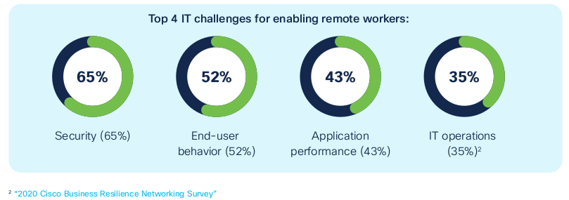

Slide 7
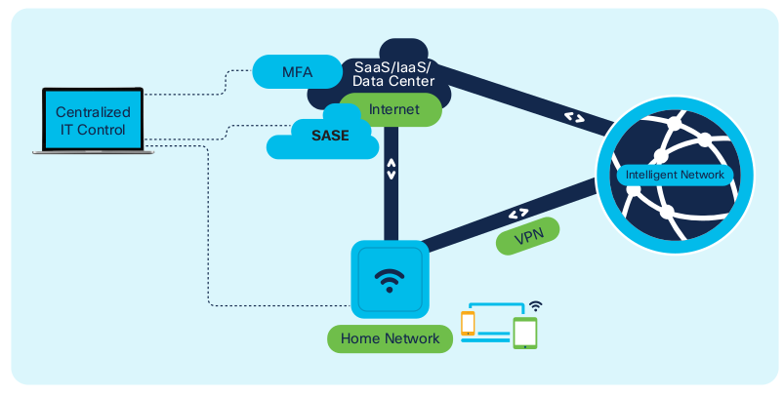
Secure remote workforce with VPN, MFA and SASE

Slide 8
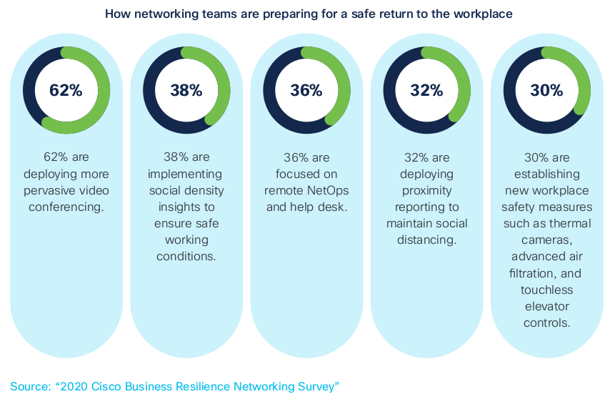
Trend #2: Workplace — Enabling safe return to on-premises workspaces

Slide 9
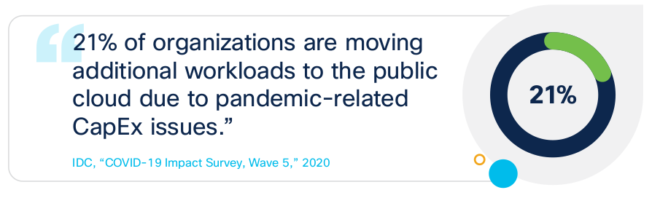
Trend #3: Workload — Facilitating multicloud for greater resilience

Slide 10
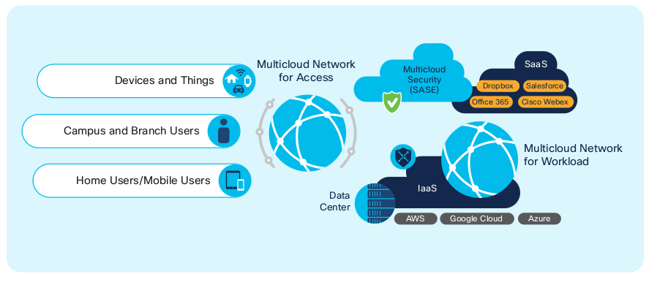
Multicloud network: workload, access and security

Slide 11
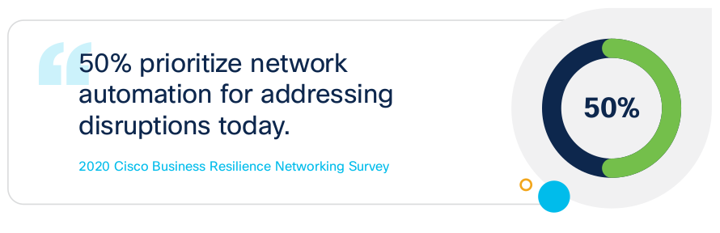
Trend #4: Operations — Automating operations for faster recovery

Slide 12
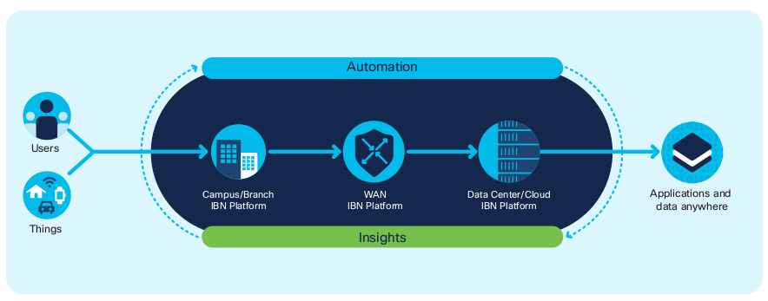
Automation and insights from user to workload anywhere

Slide 13
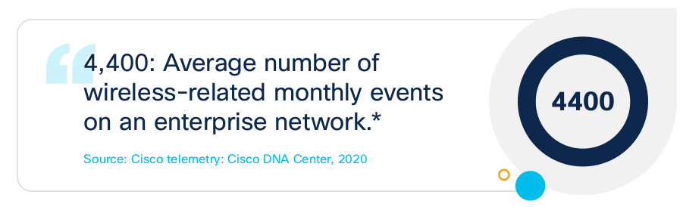
Trend #5: Operations – Leveraging AI-powered network analytics for smarter insights

Slide 14
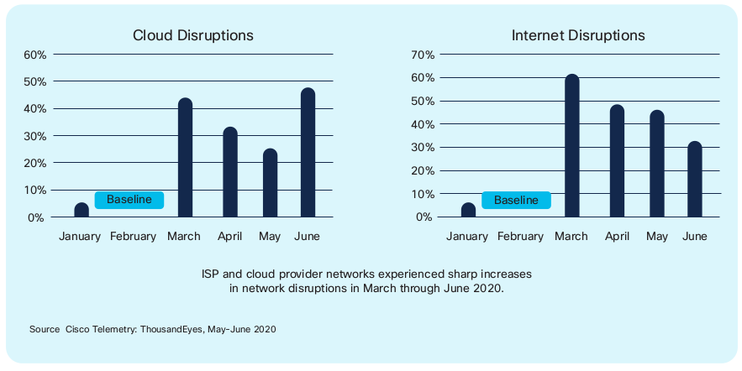
Cloud and Internet Service Disruption Increases During Pandemic

Slide 15
Intranet, Extranet, Internet

Slide 16
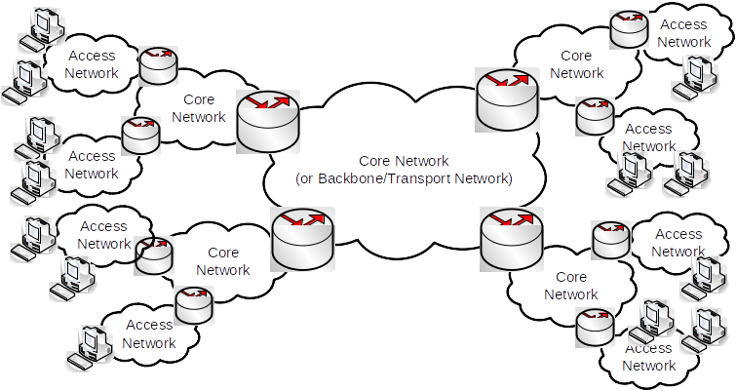
Based on users: Access Network, Core Network:

Slide 17
Based on users:
Access networks require capacity to support
Traffic between users within the same access network
Traffic from users in one access network to another
Core networks require capacity to support
Traffic between multiple access networks
Not all users send the same amount of data at the same time,
In access networks, the amount of traffic sent over time varies significantly; hence difficult to take advantage of statistical multiplexing
In core networks, the average traffic sent over time is stable; can take advantage of statistical multiplexing
Access networks are generally higher speed than core networks (for same cost)

Slide 18
Based on transmission medium:
Wired
Easy to control signal transmission
Protect from interference from other transmitting sources
Higher data rates, less errors, more predictable
Wireless
Allows mobility
Allows convenience

Slide 19
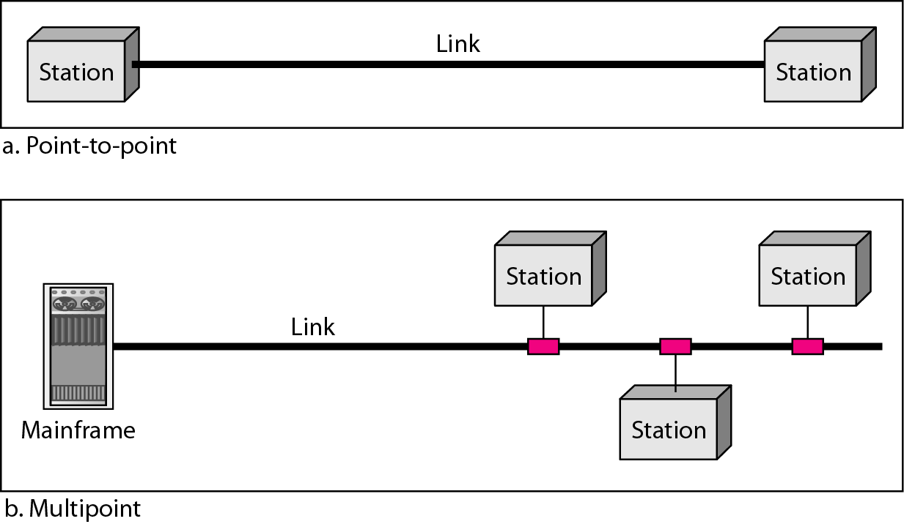
Based on link configuration:
Point-to-point (two devices)
Point-to-multipoint (shared among N devices)
Easier to allow multiple devices to communicate with each other
Harder to control the “sharing” of the medium

Slide 20
Based on user mobility:
Fixed
Devices in the network are fixed (do not move)
Easier to design network; predict traffic requirements
Mobile
Devices may be move
Difficult to know how much capacity is needed in advance

Slide 21
Ada pertanyaan?

